Slide 2
Treasure Hunting in
Azure with
KQL as Your Map
Emanuel Palm
Cloud Specialist @ Unwonted

Slide 3


What’s a pirate’s favorite Azure service? 🏴‍☠️

Slide 4

A
R
G

Slide 5

Azure Resource Graph
A
R
G
Explorer
Query the Azure management plane
Across management groups and subscriptions
Uses Kusto Query Language (KQL)
Subset of KQL supported by Log Analytics, Data Explorer, Sentinel
Based on Azure RBAC with your own permissions
Flexible usage through tooling

Slide 6
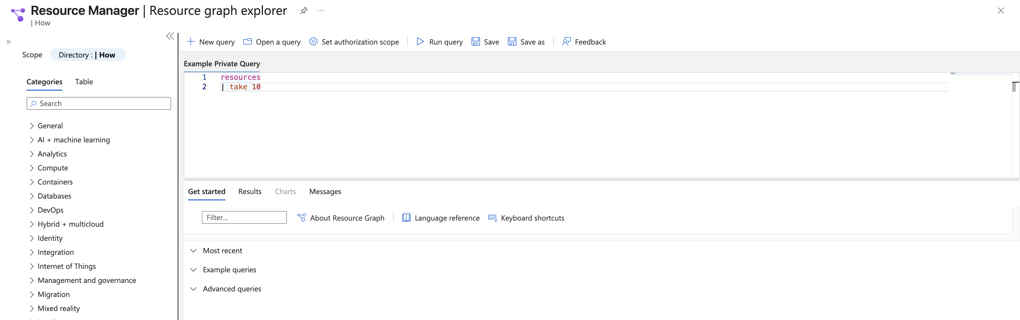
Azure Resource Graph
Explorer

Slide 7
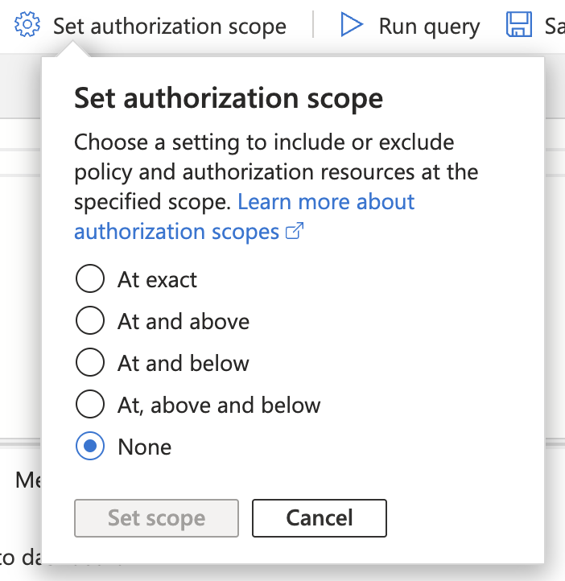
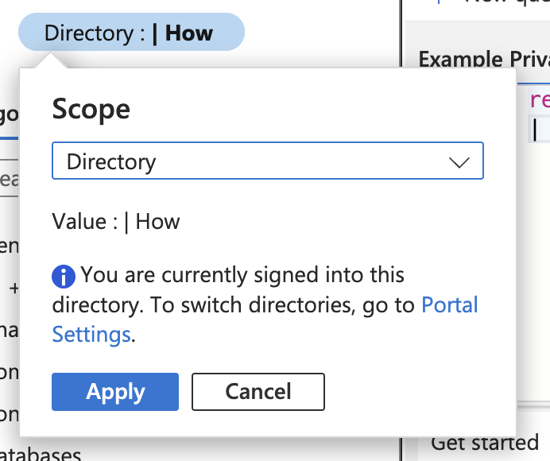
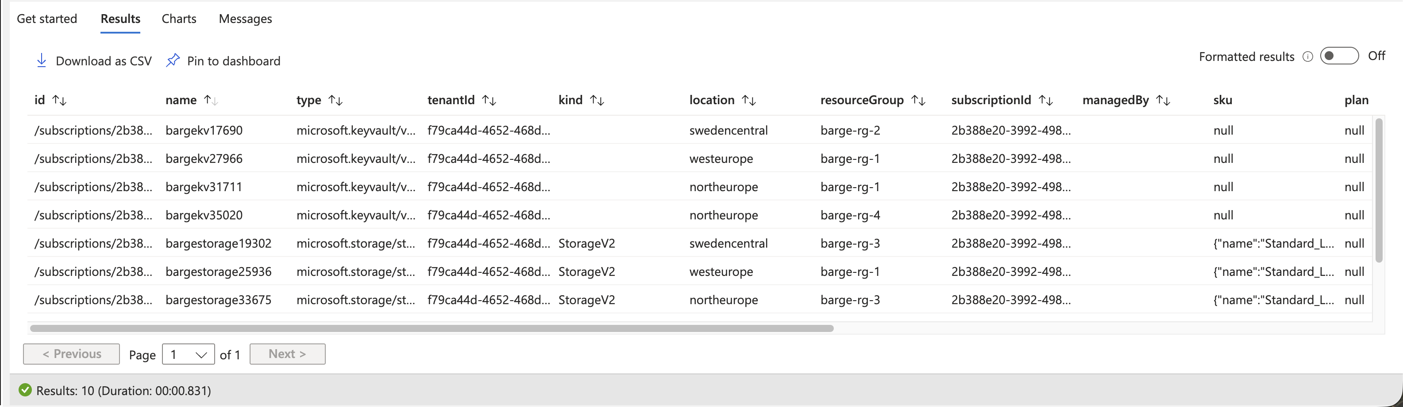
Azure Resource Graph
Explorer

Slide 8



Azure Resource Graph
boosted
Explorer

Slide 9
Azure Resource Graph
boosted
Explorer

Slide 10
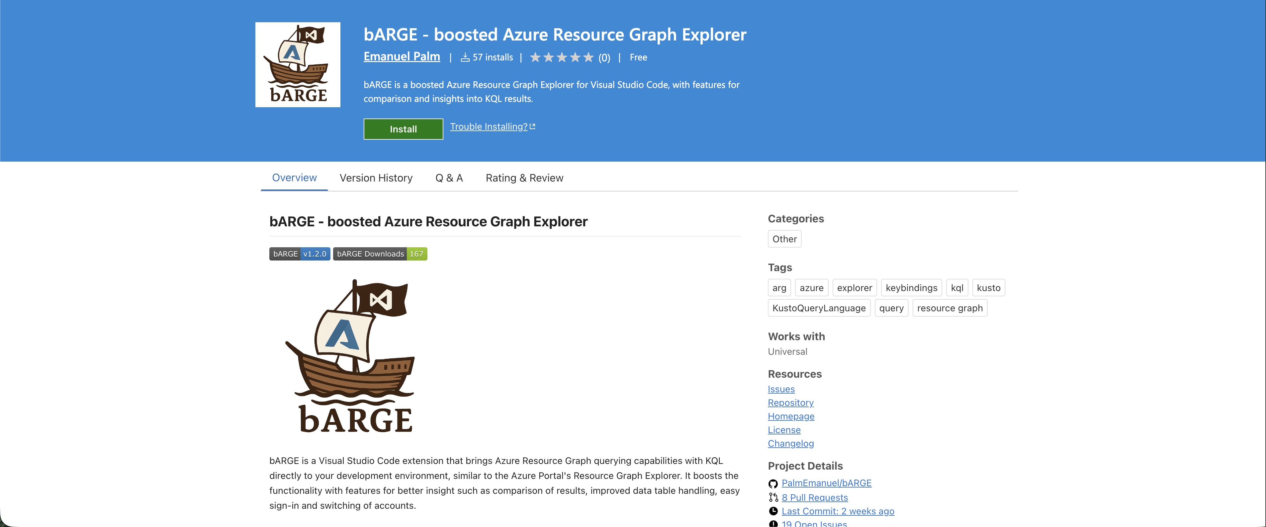

Slide 11





Emanuel Palm
💙 Everything-as-Code
📦 Makes modules & tools
📃 Fan of Open Source
☁️ Blogs at pipe.how
☕️ Roasts coffee at arkanum.coffee
🇸🇪
Cloud Specialist @ Unwonted Microsoft MVP - Azure
@PalmEmanuel

Slide 12
Notes
What is ARG?
Why do we like it - Difference to ARM
KQL - What is it, explain ARG subset vs Azure Monitor(Log Analytics)/Data Explorer/Sentinel etc
Scopes & Inheritance (authorizationScopeFilter) when querying
Limitations – 5000 subscriptions (?)
Paging
Rate limits – talk about ARG GET/LIST API
Cover dashboards, alerts and other ways to use ARG

Slide 13
Azure Resource Graph

Slide 14
ARG KQL & Syntax
Tables
Resources
ResourceContainers
AuthorizationResources
PolicyResources
Operators
where
take
project
join
Functions
tostring()
isnotempty()
rand()
Keywords
and
or
by
on

Slide 15
Case Sensitivity
Case sensitive operators
contains – contains_cs
startswith – startswith_cs
in~ - in

Slide 16
Matches Regex
Useful for matching resources by naming convention, resource ids, scopes
where name matches regex ‘^.+-(dev|test)-(kv|app)’
Role Assignment scopes

Slide 17
Ways to use Azure Resource Graph
Azure Portal
PowerShell & CLI
Rest API
VS Code (bARGE)

Slide 19
Tips & Tricks
The Resources table is the default, no need to specify it
You can use ARG from Log Analytics with arg(“”).Resources
Shared queries can be used inside queries with {{ }} syntax
Notes:
https://learn.microsoft.com/en-us/azure/governance/resource-graph/concepts/query-language#resource-graph-tables
https://learn.microsoft.com/en-us/azure/azure-monitor/logs/azure-monitor-data-explorer-proxy#query-data-in-azure-resource-graph-by-using-arg-preview
https://learn.microsoft.com/en-us/azure/governance/resource-graph/concepts/query-language#resource-graph-custom-language-elements

Slide 20
Sharing Queries
Shared queries – with in-query usage
Deployable with Infrastructure-as-Code
Code in git repositories
Log Analytics Query packs
Not directly available in ARG

Slide 21
Demo / Showcase order
Show portal experience
Simple query example
Same query from PowerShell, CLI and REST?
bARGE for a bit of the session, showcase features
In-query usage of shared queries
{{/subscriptions/00000000-0000-0000-0000-000000000000/resourceGroups/SharedQueries/providers/Microsoft.ResourceGraph/queries/Count VMs by OS}} | where x https://learn.microsoft.com/en-us/azure/governance/resource-graph/concepts/query-language#resource-graph-custom-language-elements

Slide 22
bARGE
Showcase bARGE features
Comparison

Slide 23
Other notes
Extended properties (only VMs for now)
Notes:
https://learn.microsoft.com/en-us/azure/governance/resource-graph/concepts/query-language#extended-properties

Slide 24

Install bARGE here!
Key Takeaways
Navigate the cloudy sea
ARG lets you query at scale
Find hidden treasures
Identify differences, misconfigurations, details
Hoist your sails anywhere
Use from Portal, VS Code (bARGE), CLI, dashboards, alerts and more
Emanuel Palm
Reach out!
Cloud Specialist @ Unwonted
@PalmEmanuel

